Slide 1


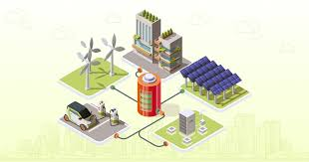
Title –
Design of IOT Architecture for
Battery Charging Management Technology
Major project 2nd Review Presentation
Presented by
Jagadeesh_(AP2312210002)
under the Esteemed guidance of
Dr. Sujith Kalluri Ph.D
Associate Professor
School of Engineering and Sciences (SEAS)
Department of Electronics and Communication Engineering
SRM University, Andhra Pradesh (SRM AP)

Slide 2

Outline
Hardware Implementation
1. Power source
2. Sources control and Automation
3. Load
→ Swapping Station
→ Fast charging Station

Slide 3
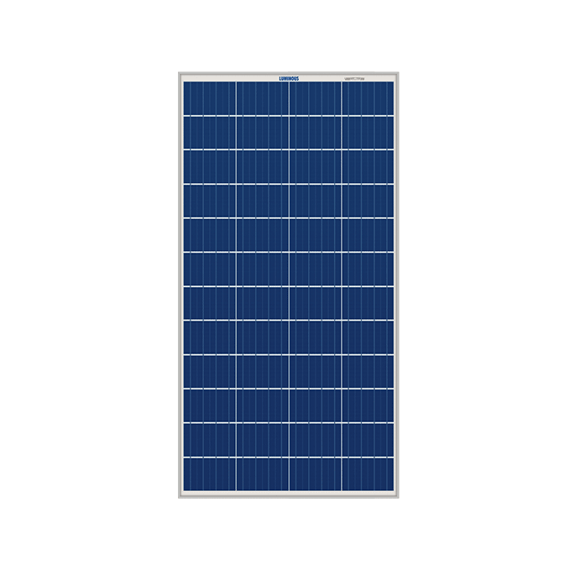
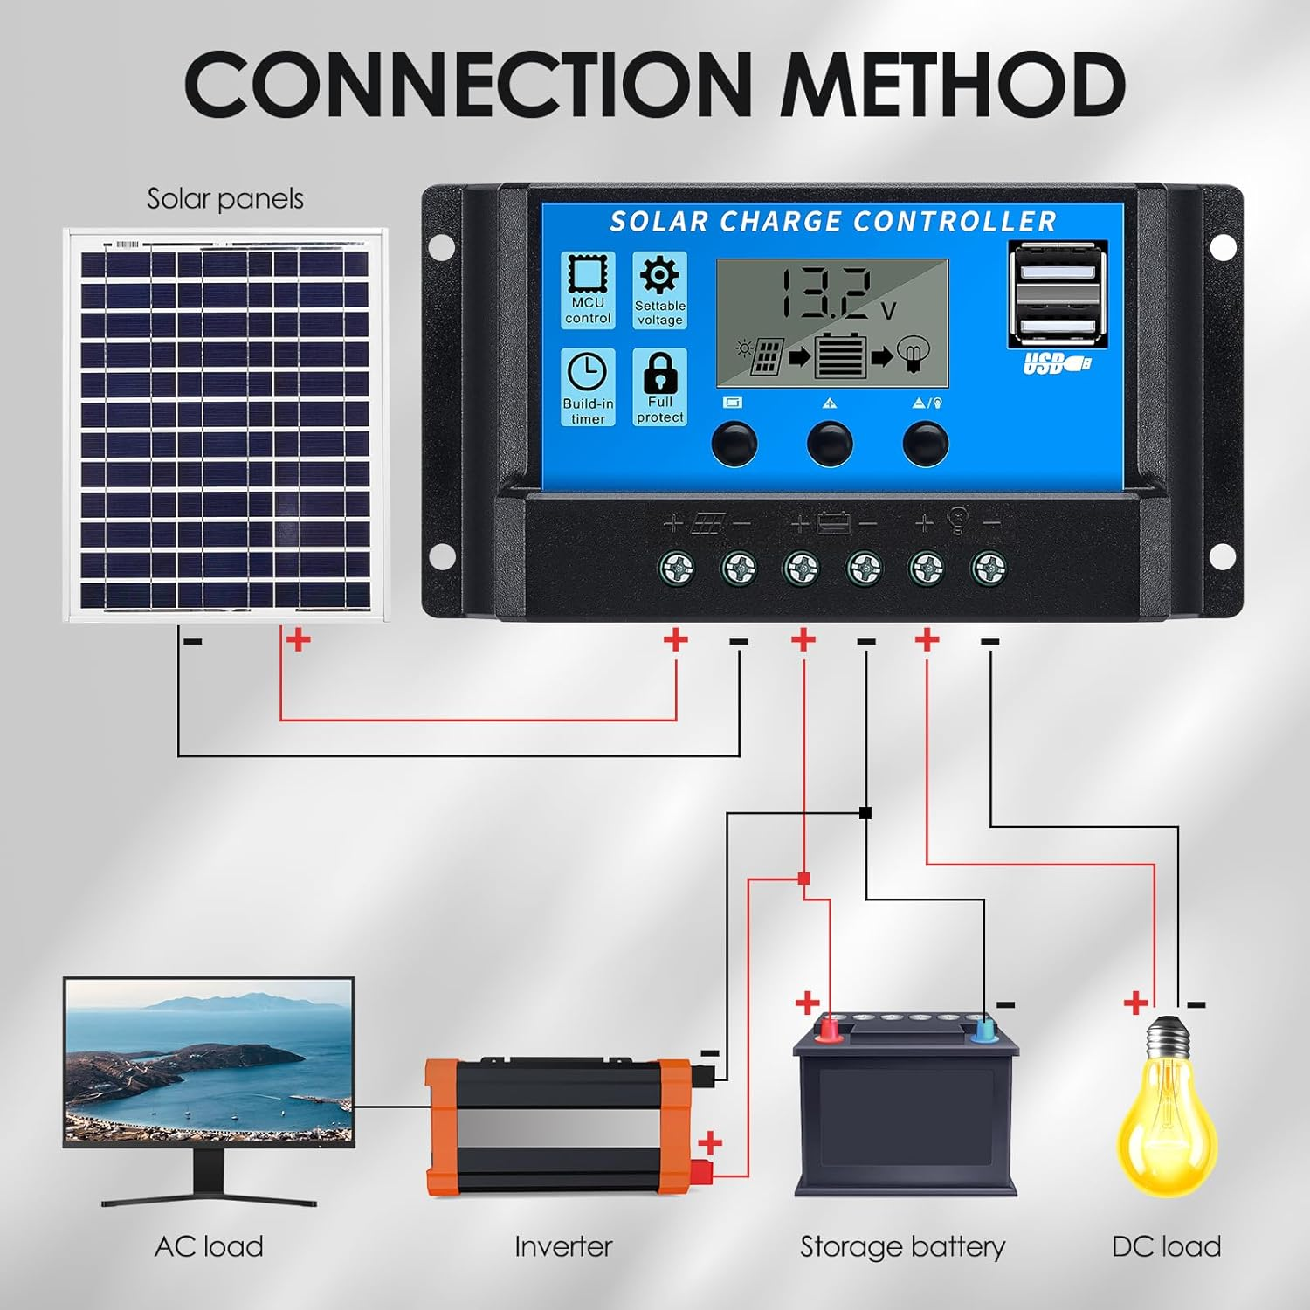
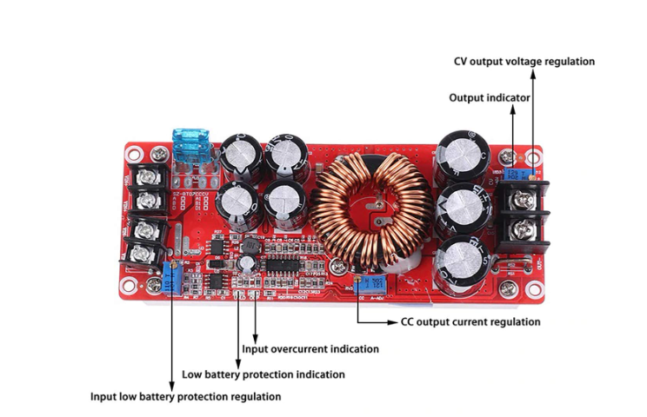
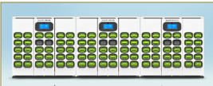
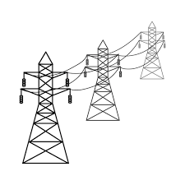
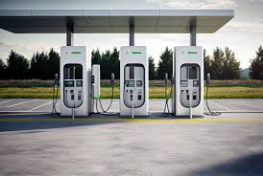
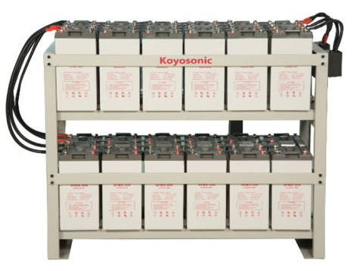
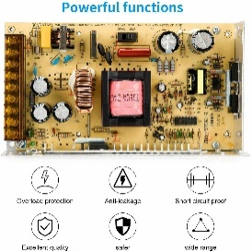
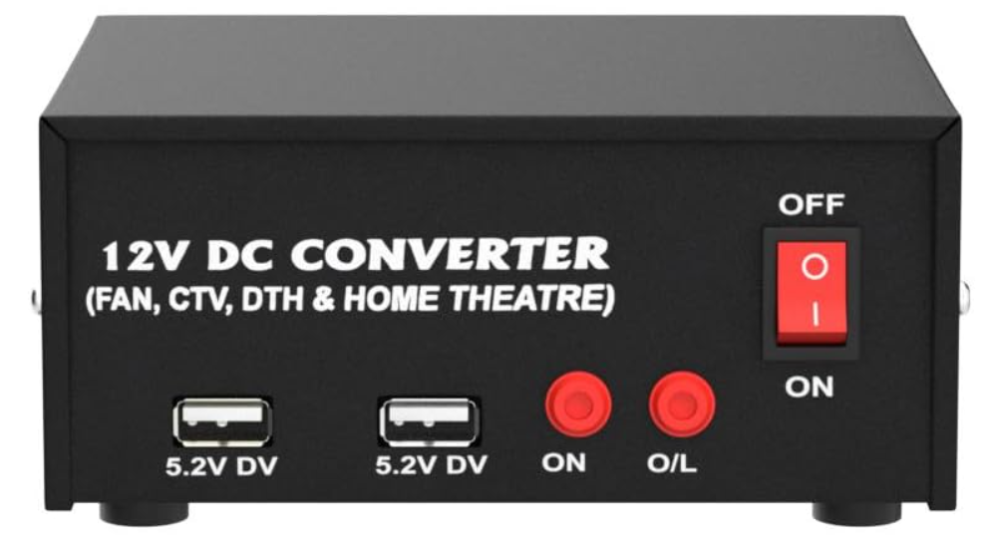
Integrating Energy source
Procurement_ Part – 1
Sources
Solar
Pannel – 1
Solar charger converter
2. ESS
Batteries -2
Grid
AC – DC - Adopter – XHM602
DC – AC Converter
Load
DC – DC Converter
1. Swapping - 10 Batteries
2. Fast charge – 12 Batteries
Solar
DC – DC
Converter
Grid
DC
AC
DC
AC

Slide 4
Automation Energy source
Solar
DC – DC
Converter
SW_1
SW_5
SW_2
Grid
DC
Conditions
Solar – ON → ESS Charge → Grid OFF → Load ON -→ [ON – S1,S2,S5] – [OFF – S3,S4]
Solar – ON → ESS >80% → [Grid DC- AC] ON → Load ON -→ [ON – S1,S2,S5,S4] – [OFF – S3]
Solar – OFF → ESS ON → Grid OFF → Load ON -→ [ON – S2,S3,S4,S5] – [OFF – S1]
Solar – OFF → ESS <20% → [Grid DC- AC] ON → Load ON -→ [ON – S3,S5] – [OFF – S1,S2,S4]
AC
SW_3
DC
AC
SW_4

Slide 5
Automation Energy Sensor monitoring
Procurement_ Part – 2
Solar
Voltage, Current, Temp, RTC, Humidity, Light Intensity, SW – M/C_1
ESS
Voltage, Current, Temp, SW – M/C_2
Grid
AC – DC - Adopter → Voltage, Current , SW – M/C_3
DC – AC Converter
Voltage, Current(AC - Sensors) SW – M/C_4
Load
DC – DC Converter
1. Swapping - Voltage, Current, SW – M/C_4
2. Fast charge – 12 Batteries Voltage, Current, SW – M/C_5
Solar
DC – DC
Converter
M-1
SW_1
SW_5
M-5
SW_2
M-5
Grid
M-3
DC
M-2
AC
SW_3
DC
AC
M-4
SW_4

Slide 6
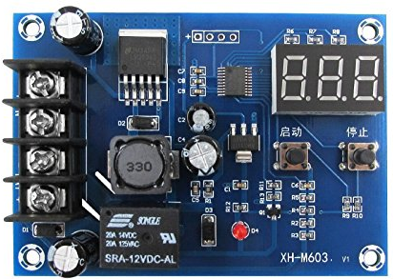
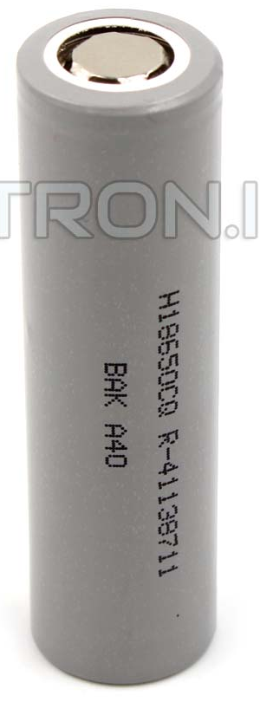
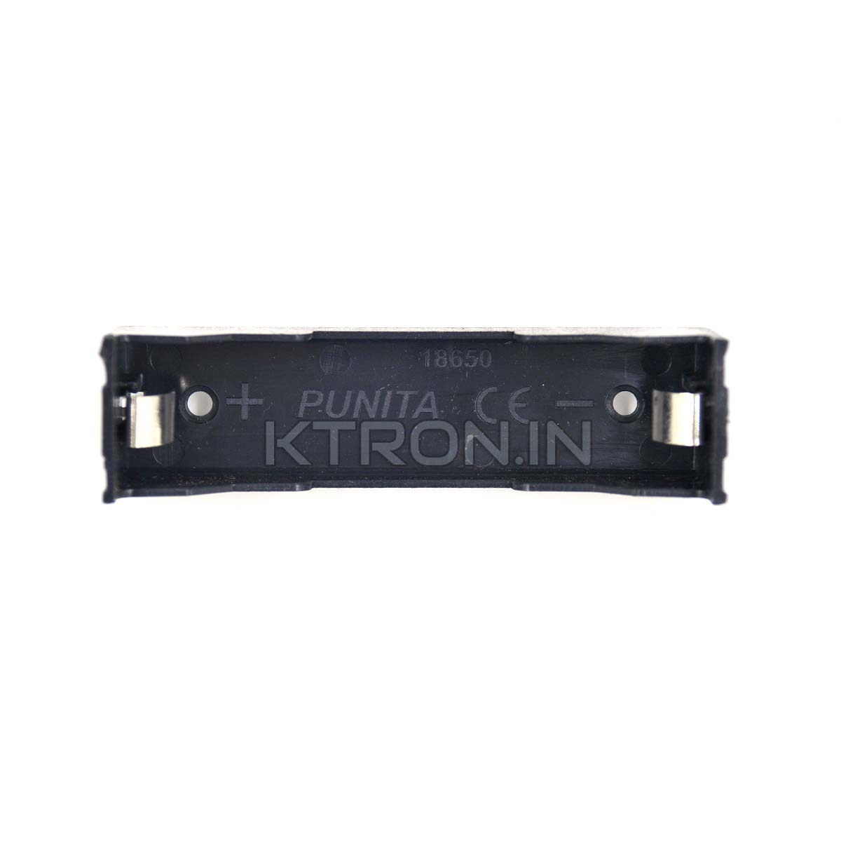
Load source
DC Power
Procurement_ Part – 3
Swapping
batteries - 10,
Centlot xt M60312V Digital charger controller
Voltage
Current
Temperature
M-5
M-6

Slide 7
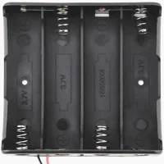
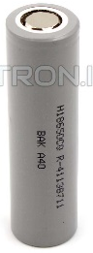
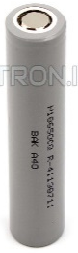
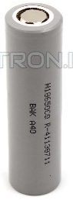
Load source
DC Power
Procurement_ Part – 4
Swapping
batteries - 3*4 = 12,
Centlot xt M60312V Digital charger controller
Voltage
Current
Temperature
M-5
M-7

Slide 8
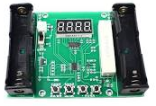
Discharge unit
Procurement_ Part – 5
Xcluma XHM240 - 18650

Slide 9
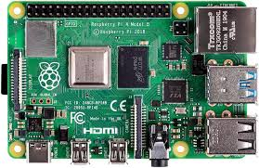



Solar
M/c – 1
Voltage, Current, Temp, Humidity, Light Intensity, SW – On/OFF
ESS
M/c – 2
Voltage, Current, SW – On/OFF
M/C – 1
M/C - 2
M/C - 3
M/C - 4
Grid
AC – DC - Adopter → Voltage, Current , SW – M/C_3
DC – AC Converter
Voltage, Current(AC - Sensors) SW – M/C_4

Slide 10
Swapping station
M/c – 5
Voltage, Current SW – On/OFF
M/C – 1
M/C - 2
Fast Charging
M/C_6
Voltage, Current, SW – M/C_4

Slide 11

Thankyou
Talk to yourself once in a day,
otherwise, you may miss meeting an intelligent person in this world. Swami Vivekananda
Harnessing renewable energy through innovative battery charging solutions not only reduces operational costs but,
IOT Integration is the way for a sustainable future, enabling us to power our vehicles while preserving our planet.

